Slide 1
Maven Repository Management and Maven Multi Module Project
~By Naincy Gupta

Slide 2

Index
Nexus Download Link
How to install Nexus
Maven Repository Management
What is maven
Maven Coordinates
Maven Repository Layout Mapping
Primary and Secondary artifacts
Checksum
Maven Repository
Types of maven repository
Release and Snapshot Repository
Repositories v/s distribution Management
How to create release and Snapshot repository
Maven Multi Module Project
Structure of Maven Multi Module Project
Benefits of using maven multi module project
Example of maven multi module project
Technical overview of peripheral multi module project
Queries

Slide 3
What is nexus repository ?
Nexus is repository that manages the software “artifacts” required for the development.
If you develop your software, your build can downloads the dependencies from the nexus and publish the artifacts to the nexus.

Slide 4
Nexus Repository Manager Download Link
https://help.sonatype.com/repomanager2/download

Slide 5
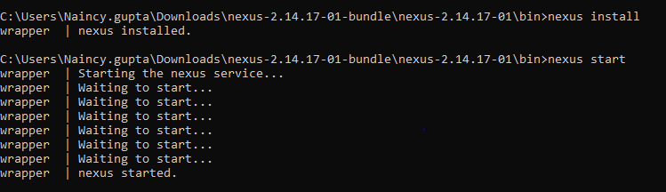
How to install and run the NRM
Unzip the downloaded folder.
Go to Drive/nexus-2.14.17-01-bundle\nexus-2.14.17-01\bin
Open CMD (Administrator Mode).
Run the Install command for installing the NRM.
Run the start command for running the NRM.

Slide 6
Maven Repository Management
What is Maven Dependency ?
Maven dependency is an artifact that your project needs to have during maven Build LifeCycle.
These are declared in the <dependencies> tag in the pom.xml.
Maven Coordinated
Most dependency declarations consist of, groupId, artifactId and version filed. A group of these key value pair is know as Maven Coordinated for a particular dependency.
How Does Maven Locate and resolve dependencies
Maven uses the coordinates values for a given dependency to construct a URL according to the maven repository layout.
Maven Repository Layout Mapping

Slide 7
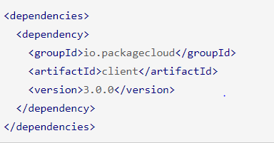


Maven Repository Management cont.…
Primary artifact:
One of the core features of Maven is its ability to handle Transitive Dependencies. That is, to find and download the dependencies of your dependencies, and their dependencies also, recursively, until they are all satisfied.
Just how your own Maven project has a pom.xml file listing its main dependencies, those dependencies also have a remote pom file serving a similar purpose. Maven uses this file to figure out what other dependencies to download. When a coordinate does not contain a classifier it is considered a primary artifact and is expected to have a pom available.
Secondary artifact:
Secondary artifacts, or “attached artifacts”, are dependencies that you want maven to download. Most often they are used to download the javadocs and sources. However, unlike a primary artifact, a secondary artifact is not expected to have a remote pom.

Slide 8
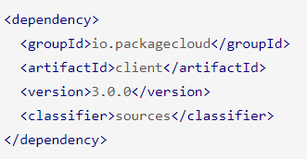
Maven Repository Management cont.…
CheckSum
To verify the downloaded artifacts Maven computes the md5 and sh1 checksum for that artifacts and compares it to the values found in the checksum files located at repository.

Slide 9
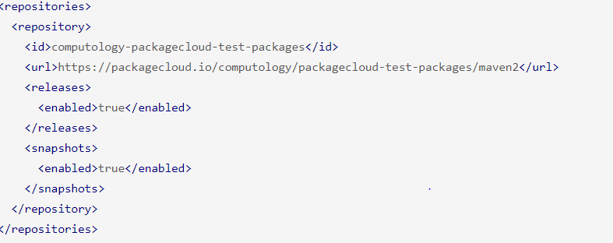
Maven Repository Management cont.…
Introduction to maven repository:
A Maven repository provides a standard for storing and serving binary software.
Maven repository is wherever these constructed artifact URLs live.
Maven and other tools with repositories to search for binary software artifacts, locate project dependencies.
Types of Repositories:
1- Local Repository :
Before Maven attempts to download a particular artifact from a remote repository it checks the local repository. This is usually located at .m2/repository. The local repository follows the same standard repository layout as remote repositories.
2- Remote Repository :
Remote repositories are defined in your project’s pom.xml file under the </repositories> section

Slide 10
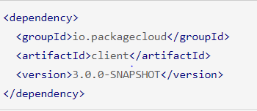
Maven Repository Management cont.…
If you are on Maven 2.x, then this would be <repository> and <sanpshotRepositry> respectively.
Release and Snapshot Repositories:
1- Release repository :
These are specific, point-in-time releases. Released artifacts are considered to be solid. The Central Maven repository stores release artifacts. These are artifacts that once published to a coordinate, must not be changed.
2- Snapshot Repository:
Snapshots capture a work in progress and are used during development.
These version values have to end with -SNAPSHOT in the POM file. This allows repeated uploads.
The idea is that you can continuously push your latest changes to 3.0.0-Snapshot and anyone depending on it will get the latest changes every time they build their project. Then, after a few iterations, and everyone is happy the latest state of 3.0.0-snapshot it can be permanently released as 3.0.0

Slide 11
Difference between Repositories Tag and Distribution Management Tag in Pom.xml
Repositories declared under the distrubutionManagement tag element will be used for deployment, i.e. when running mvn deploy command.
The repositories element will be used for downloading the dependencies of the project.

Slide 12
How create the snapshot and release repository
Give Demo on Nexus

Slide 13
Maven Repository Management cont.…
Maven-metadata.xml File:
In order to determine the the latest artifact to download for a particular Snapshot version, Maven uses the Standard Repository Layout to locate a Maven-metadata.xml for that dependency

Slide 14
What we are using the Maven Multimodule project.
As our project is required the lot of external jar and dlls so that it can integrate with the Peripheral devices like Barcode Scanner, Receipt printer etc.
So what we do with the help of the Maven Multimodule project we add JARs and DLLs in GitLab Repository which further gets integrated with Jenkins Pipeline to publish the artifacts in Nexus Repository so that they can be imported as dependencies in any project.

Slide 15
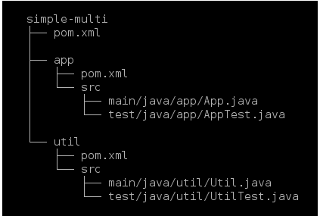
Maven Multimodule Project/Maven Parent and Child Module Project
Maven provide support of the Multiple Module project that is one parent with multiple submodules/child project and all the modules built in a single command
The directory simple –multi is the top directory of the multi module project. It contains the parent POM also known as Top level /aggregator pom.
But the top level directory doesn’t contain any source folder.
Along with the parent pom , the top level directory also contains two sub folders – app and until .These module folder are regular maven project with source directories and POM.xml
The top level as well as module POM differs slightly from the regular POM.
Structure of Multimodule Project:

Slide 16
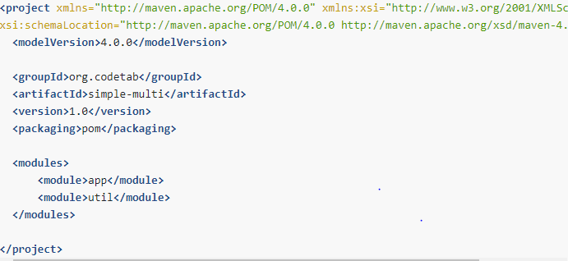
Aggregator POM.XML/ Top-Level POM.XML
It defines project coordinates-groupId, artifactId and version – as in any normal project, but the packaging types is specified as pom instead of usual jar or war. Since top level project doesn’t contain any source directory, packaging is set as pom.

Slide 17
Maven Reactor
While declaring the modules in parent POM there is no need to bother about their ordering as Maven uses software component called reactor to properly order the modules.

Slide 18
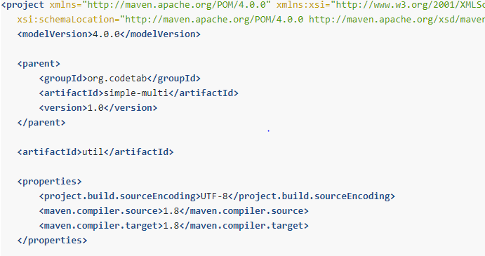
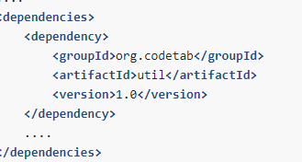
Submodule POM.XML
.
The content Submodule Pom.xml
The parent element specifies the coordinate(groupId,artifactId and version )of the parent project i.e. simple- multi, while the coordinates of the util module is defined using just the artifactId element. There is no need to specify groupId for the module they are derived from the parent.
Now if the app submodule depends upon the util sub module or we can say when one module is depend on the another module, then the dependency is specified as :

Slide 19
Benefits of Using Multi Module Project
The key advantage of using the multi module project is that it reduces the Duplication.
We can build our application's modules in a single command.

Slide 20
Basic Example Of Multi Module Project
Show STS Example

Slide 21
Peripheral Epson Jar Multimodule Technical Overview

Slide 22

Queries

Slide 23
Thankyou

